Slide 1



W2D5 - Promises

Slide 2

Agenda
CALLBACKS (again?)
PROMISES
CALLBACK HELL
CHAINING
Advanced Items if we have time

Slide 3

Callbacks
A Review
Notes:
What are callbacks? Anyone remember what these are?

Slide 4

I just met you, And this is crazy, But here's my number (delegate), So if something happens (event), Call me, maybe (callback)?
It’s me again!
Notes:
There are three things here, Event, Delegate, and Callback.
Delegates in are interchangeable with Callbacks in Javascript. In languages like C# and Java they are important.
Events in JavaScript are mechanisms that enable the subscription and notification of specific actions or occurrences, allowing for decoupled and modular code.
Callbacks in JavaScript are functions that are passed as arguments to asynchronous operations, allowing for the execution of code once the operation completes, ensuring non-blocking behavior.

Slide 5
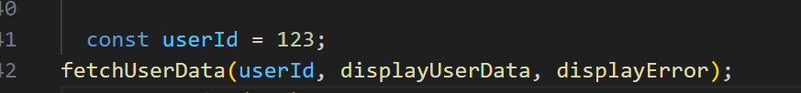



CALLBACKS
Parameters
Function
CallBack Function
Notes:
Callbacks can be synchronous or asynchronous

Slide 6
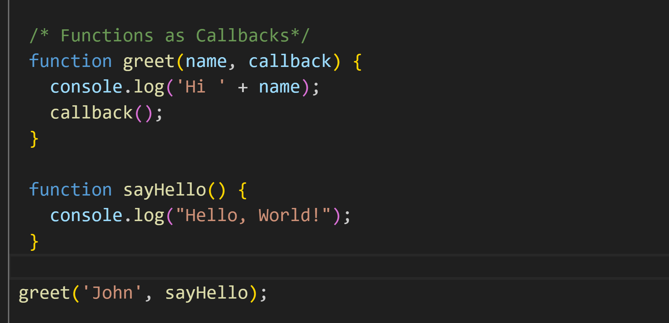
FUNCTIONS AS CALLBACKS
Passing a function into another function as an argument
Notes:
A callback function is a function that is passed into another function as an argument, which is then invoked inside the outer function to complete some kind of action or routine.

Slide 7
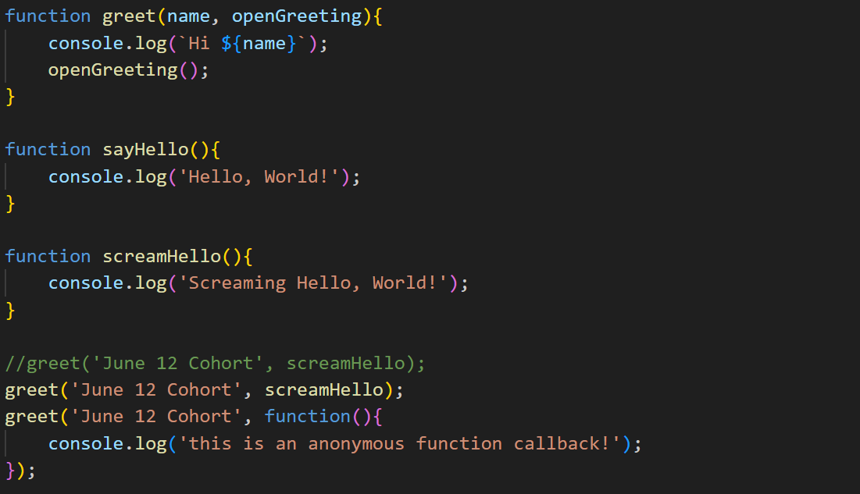
CALLBACKS – BIGGER REVIEW
Notes:
Why Callbacks?
Modularity? Flow Control? Error Handling, Reusable, Event Handling.
Callbacks in JavaScript are used to handle asynchronous operations by specifying the behavior to be executed once the operation is completed.
Callbacks are commonly used to respond to events in JavaScript, allowing custom behavior for actions like button clicks or timer triggers.
Callbacks enable error handling in asynchronous operations, defining how the code should react when an error occurs.
Callbacks promote modularity and code reusability by dynamically defining a function's behavior through passed-in callbacks.
Callbacks provide control flow in asynchronous scenarios, allowing the order of operations and handling dependencies between tasks.
Callbacks align with functional programming principles, enabling the passing of functions as arguments and facilitating code clarity and reusability.

Slide 8
PROMISE
A Review
Notes:
JavaScript Promises are a modern approach to handle asynchronous operations. Although we can handle small small asynchronous operations using callback functions, but not large operations. Promises can handle long and nested asynchronous operations easily.
Note* Callbacks aren’t inherently asynchronous. They’re a pattern where a function is passed into an argument. They are used in both Async and Synchronous contexts.
Remember, Sycnrhonous callbacks block execution of the code until they are completed.
Async callbacks on the other hand are typically used with async operations such as API Calls, or event handling.

Slide 9
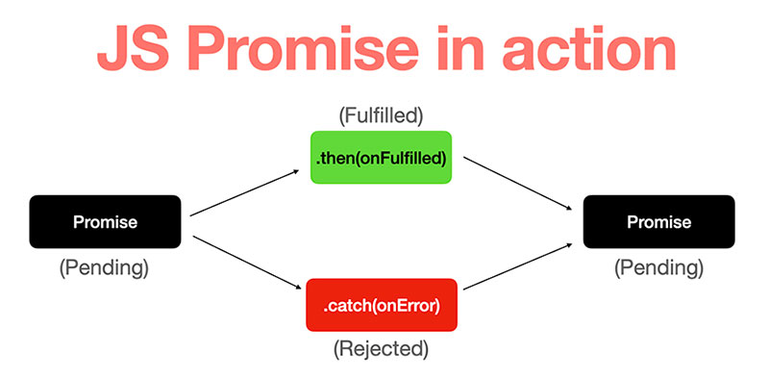
Notes:
JavaScript Promises are a modern approach to handle asynchronous operations. Although we can handle small small asynchronous operations using Callback Functions, but not large operations. Promises can handle long and nested asynchronous operations easily.
Promises have Three Potential States which we will look at shortly.

Slide 10
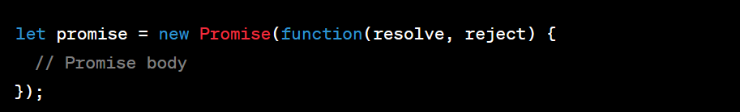
PROMISES
Let’s Break this down. A promise is:
An Object
Represents “the eventual end” of an async operation.
Serves as a placeholder for the eventual results
Notes:
A Promise in JavaScript is an object that represents the eventual completion or failure of an asynchronous operation. It serves as a placeholder for the eventual results of the operation.

Slide 11
PROMISES
Three States:
Pending: The Promise's outcome hasn't yet been determined, because the asynchronous operation that will produce its result hasn't completed yet.
Fulfilled: The asynchronous operation has completed, and the Promise has a resulting value.
Rejected: The asynchronous operation failed, and the Promise will never be fulfilled. In the rejected state, a Promise has a reason that indicates why the operation failed.
Notes:
Easy Example
Pending State: You’ve been given a receipt with a number.
Fulfilled: Your order is ready! You present the ticket and get your meal :) OR
Rejected: They’re out of burgers! :( Your order cannot be fulfilled. It’s rejected!
Another Example:
You’re Having a birthday Party.
You order a Cake.
Fulfilled – you get a cake
Rejected – they didn’t get you a cake
But, you are still having a birthday party.

Slide 12
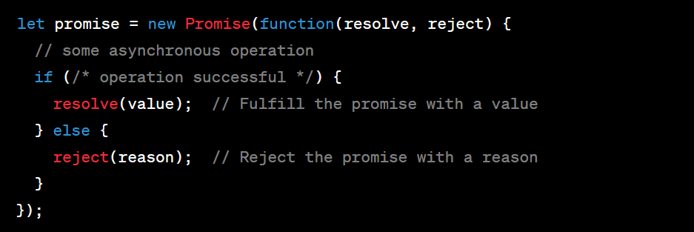
PROMISES
Let’s dig into some keywords: Resolve, Reject, Then, Catch

Slide 13
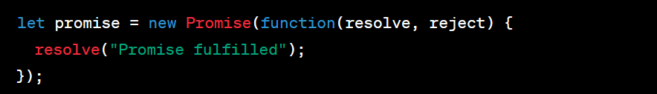
RESOLVE
Resolve: This is a function that is passed to the executor function when creating a new Promise. When this function is called in the executor function, it changes the state of the Promise from "pending" to "fulfilled". The value passed to the resolve function becomes the result of the Promise.

Slide 14
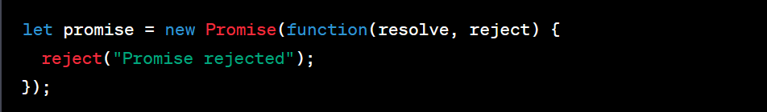
PROMISES
Reject: This is another function that is passed to the executor function when creating a new Promise. When this function is called in the executor function, it changes the state of the Promise from "pending" to "rejected". The value passed to the reject function becomes the reason for the Promise's rejection.
Notes:
You might be asking – what is an executor function??
an executor function is the function that you pass to the Promise constructor when creating a new Promise. This function is executed immediately by the Promise implementation and it receives two arguments: resolve and reject, which are both functions.
In the executor function, you perform the asynchronous operation or computation. If the operation is successful, you call the resolve function with the result value. If the operation fails, you call the reject function with the reason for failure.
The resolve and reject functions are used to change the state of the Promise. When resolve is called, the Promise's state changes from "pending" to "fulfilled". When reject is called, the Promise's state changes from "pending" to "rejected".

Slide 15
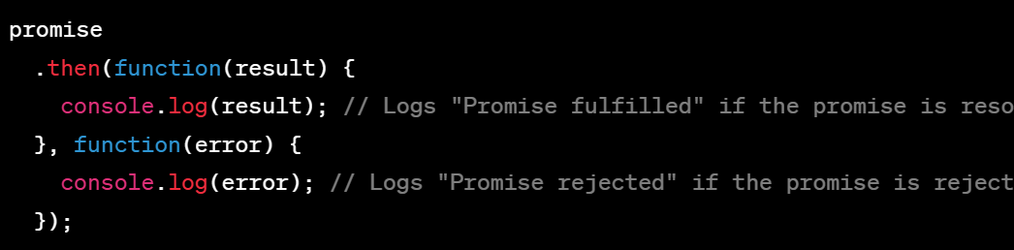
PROMISES
Then: This is a method that is called on a Promise. The then method takes two optional arguments, both of which are callback functions. The first callback is executed when the Promise is fulfilled, and the second callback is executed when the Promise is rejected. The then method returns a new Promise, allowing for method chaining.

Slide 16
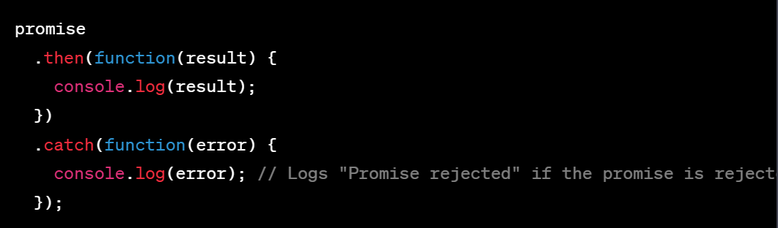
PROMISES
Catch: This is a method that is called on a Promise to handle any rejection reason. The catch method takes one argument: a rejection reason callback. This method is typically used at the end of a Promise chain to handle any errors that may have occurred in the chain.

Slide 17
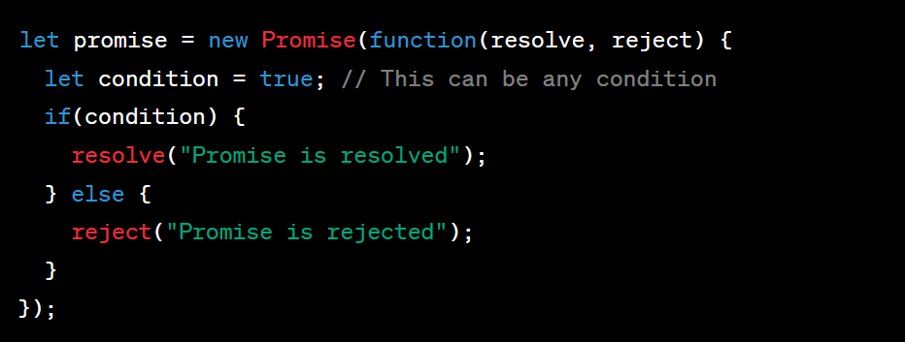
CREATE A PROMISE
Notes:
Discuss the new Promise() constructor and its two parameters: resolve and reject.
Explain how resolve is a function that, when called, changes the Promise's state from pending to fulfilled.
Explain how reject is a function that, when called, changes the Promise's state from pending to rejected.

Slide 18
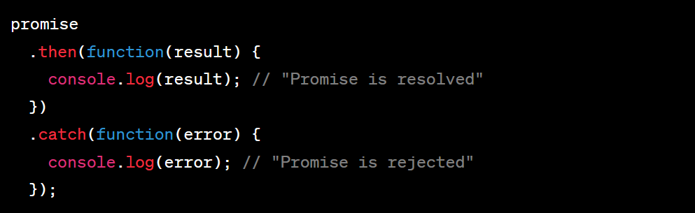
CONSUMING A PROMISE
Notes:
Discuss how .then() is used to schedule a callback function to be run when the Promise is fulfilled.
Discuss how .catch() is used to schedule a callback function to be run when the Promise is rejected.
Explain that these methods return a new Promise, allowing for method chaining.

Slide 19
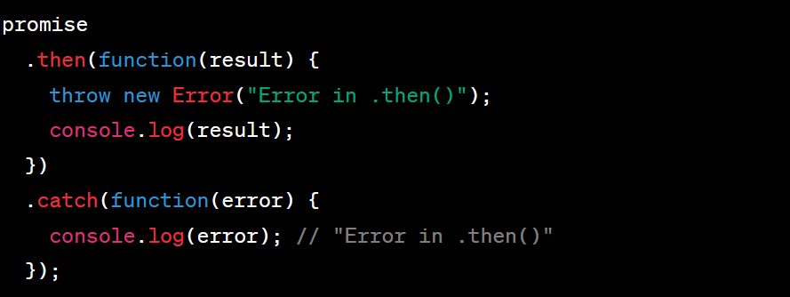
ERROR HANDLING IN A PROMISE
Notes:
Discuss how errors can be handled in Promises using .catch().
Explain that .catch() catches any error that is thrown in a .then() callback.
Discuss how unhandled Promise rejections are treated as uncaught exceptions.

Slide 20
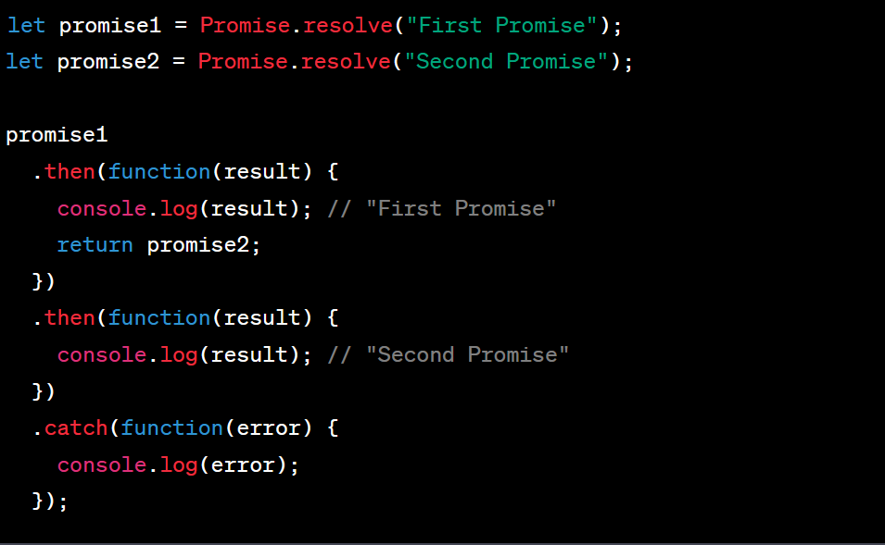
CHAINING A PROMISE
Notes:
Promise chaining is a technique in JavaScript where you chain .then() methods together to perform multiple asynchronous operations in sequence. Each .then() returns a new Promise, which resolves to the value returned by its callback. This allows the result of one asynchronous operation to be used as the input for the next.
This is a bit of an advanced promise subject.

Slide 21
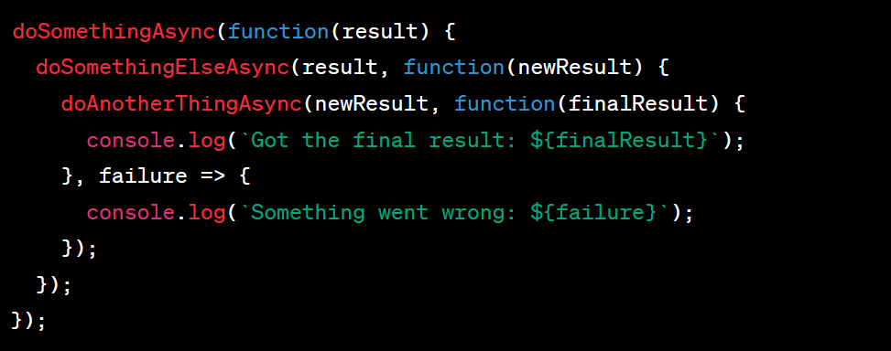
CALLBACK HELL (Ugly…)
Notes:
Callback hell, also known as the pyramid of doom or the Christmas tree problem, is a phenomenon that afflicts a JavaScript developer when they try to execute multiple asynchronous operations one after the other.
In JavaScript, asynchronous operations are often handled using callback functions. A callback is a function that is passed as an argument to another function and is expected to execute after some kind of event. This works well for single asynchronous operations, but when you need to perform several operations in a row, each of which depends on the successful completion of the previous operation, you end up nesting these callbacks within each other. This leads to code that is hard to read and understand, hence the term "callback hell".
As you can see, the code becomes increasingly indented with each asynchronous operation, forming a pyramid shape. This makes the code difficult to read and maintain. It also makes error handling more complex, as each callback needs its own error handling code.
Promises and async/await are modern features of JavaScript that help to solve callback hell by making asynchronous code look more like synchronous code, improving readability and making error handling simpler.

Slide 22
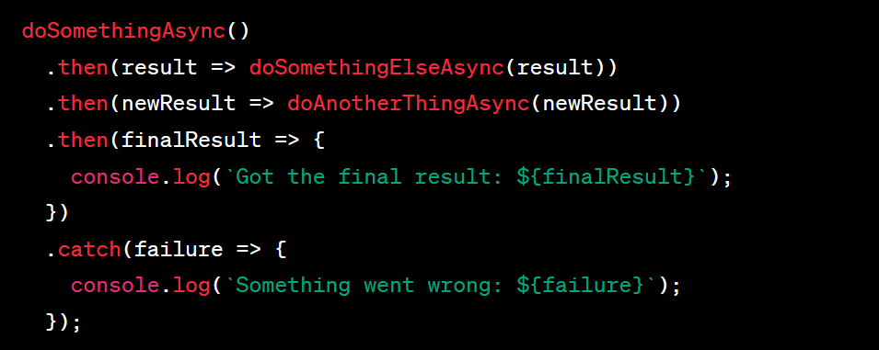
FIXING CALLBACK HELL
Notes:
Promise chaining is a technique in JavaScript where you chain .then() methods together to perform multiple asynchronous operations in sequence. Each .then() returns a new Promise, which resolves to the value returned by its callback. This allows the result of one asynchronous operation to be used as the input for the next.
In this example, doSomethingAsync, doSomethingElseAsync, and doAnotherThingAsync are all functions that return Promises. The result of each asynchronous operation is passed to the next .then() in the chain.
As you can see, Promise chaining results in code that is much easier to read and understand than nested callbacks. It also makes error handling simpler, as a single .catch() at the end of the chain can catch errors from any step in the chain.

Slide 23
Questions?

Slide 24
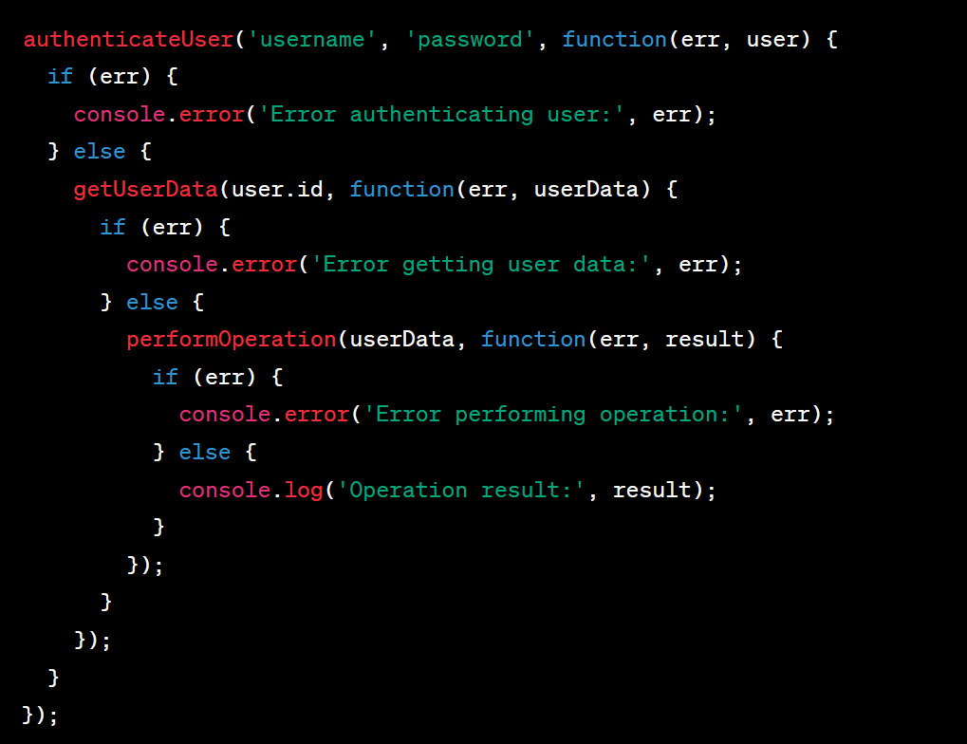
REAL WORLD (if time)
Notes:
In this example, authenticateUser, getUserData, and performOperation are all asynchronous functions that take a callback as their last argument. Each callback checks for an error and handles the result of the asynchronous operation. If an error occurs at any point, it's logged and the subsequent operations are not performed.
As you can see, the code becomes increasingly indented with each asynchronous operation, forming a pyramid shape. This makes the code difficult to read and maintain. It also makes error handling more complex, as each callback needs its own error handling code.
This is a typical example of callback hell. Promises and async/await are modern features of JavaScript that help to solve callback hell by making asynchronous code look more like synchronous code, improving readability and making error handling simpler.

Slide 25
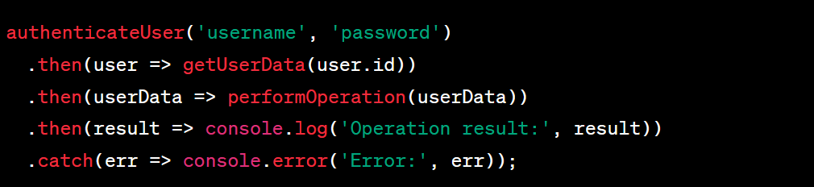
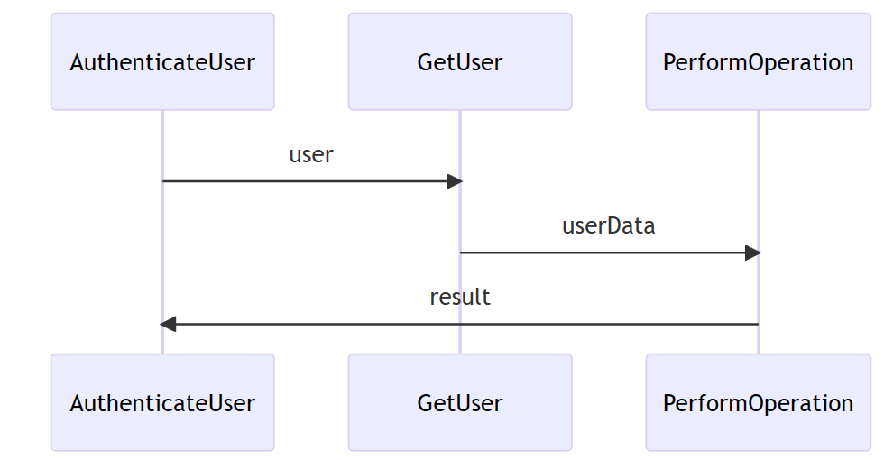
REAL WORLD (if time)
Notes:
In this version, authenticateUser, getUserData, and performOperation are all functions that return Promises. The result of each asynchronous operation is passed to the next .then() in the chain.
If an error occurs in any of the Promises, the error is caught and handled by the .catch() at the end of the chain. This makes error handling much simpler and more centralized compared to the callback-based version.
This is a much cleaner and more readable way to handle multiple asynchronous operations in sequence. It avoids the deep nesting of callbacks, making the code easier to understand and maintain.

Slide 26
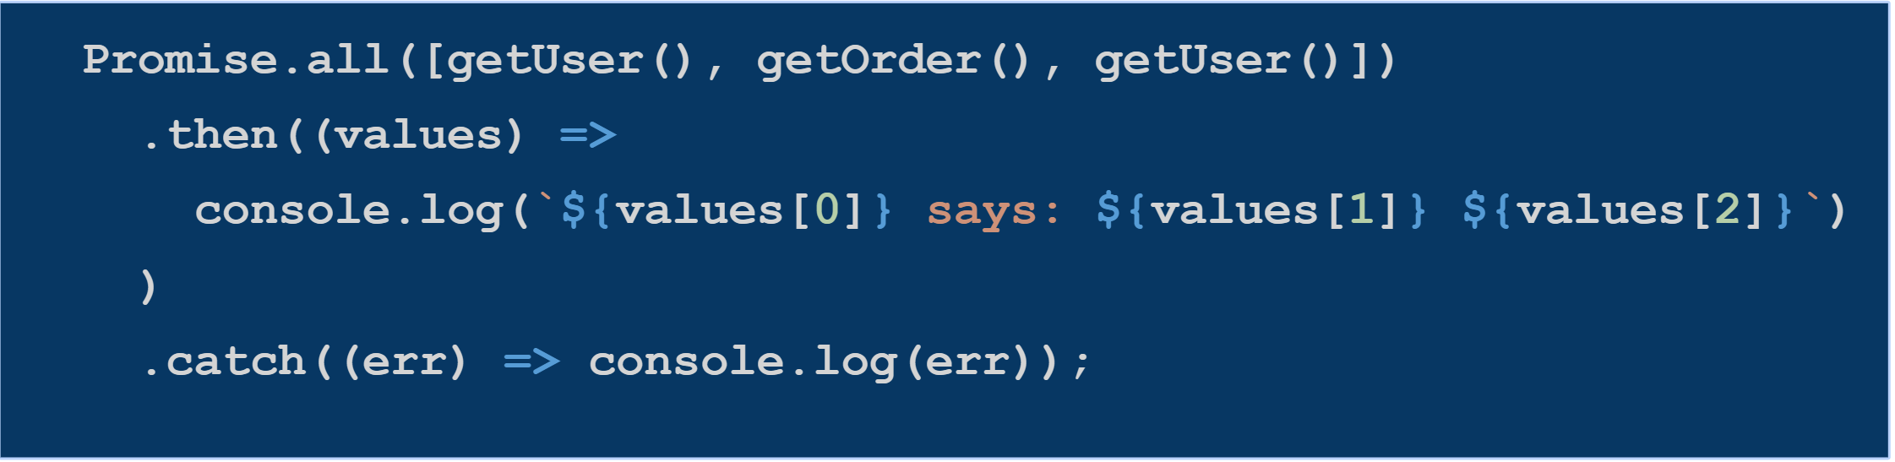
Promise.all
Use Promise.all when we need to wait for all of the promises to be resolved.

